Slide 1
Day 1 – Introduction to Jira
by
Amit Luthra

Slide 2
Table of Contents – Day 1
JIRA Key Concepts
Getting started with JIRA
How to Create Sprints
How to Create Epic
How to Create Stories, Task, Sub Tasks and Bugs
How To link Issues with User Stories
What is Story Points
Introduction to Workflows

Slide 3
JIRA Key Concepts
JIRA is a tool developed by Australian Company Atlassian. It is used for bug tracking, issue tracking, and project management.
Basically, it is used for project management, service helpdesk, as Incident tracker etc..

Slide 4
Introduction to Issues
In Jira, Issue Type displays all types of items that can be created and tracked via JIRA. JIRA Issues are classified under various forms like Story, Task, sub-task, bug, etc.
Lets see in detail as how to create issues in jira

Slide 5
What is Sprint
A sprint — also known as an iteration — is a short period in which the team implements and delivers a discrete and potentially shippable application increment, e.g. a working milestone version.
If you haven't run sprints before, we recommend using a fixed two-week duration for each sprint.
In Jira Software, you view sprints on a board and assign issues to sprints.

Slide 6
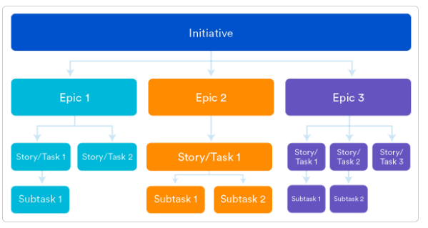
What is Epic
EPIC :- An epic is a large body of work that can be broken down into a number of smaller stories, or sometimes called “Issues” in Jira.
Epics often encompass multiple teams, on multiple projects, and can even be tracked on multiple boards.
Epics are almost always delivered over a set of sprints.

Slide 7
What is Story, Task , sub Task and Bugs
Story :- User stories are a key element in the agile methodologies. They’re an essential strategy for communicating requirements to the development team. It’s important that the person tasked with documenting feature requirements is able to write effective and accurate user stories.
A user story is an informal, general explanation of a software feature written from the perspective of the end user. Its purpose is to articulate how a software feature will provide value to the customer.
Most user stories follow this template:
As a [type of user], I want to do [X[, so that I can [achieve goal X].
For example:
As an Admin, I want to have access to the database so that I can reset the user password.

Slide 8
What is Story, Task , sub Task and Bugs
Task
A task represents work that needs to be done.
Subtask
A subtask is a piece of work that is required to complete a task.
Bug
A bug is a problem which impairs or prevents the functions of a product.

Slide 9
What is Story Points
There's a huge variety of ways to estimate stories, but the objective of every approach is to be able to get better at predicting how much work the team can do each sprint.
Even when you estimate in story points, you can still track in time if you want. Knowing the team velocity (regardless of the measure used) enables you to roughly guess how long estimated backlog items will take to complete.
Jira Software does also have a couple of dedicated fields (Remaining Estimate and Time Spent) to track time while using story points.

Slide 10
Introduction to Workflows
A JIRA workflow is a set of statuses and transitions that an issue goes through during its lifecycle. JIRA workflow encompasses five main stages once the issue is created.
Open Issue
Resolved Issue
In Progress Issue
Re Opened Issue
Close Issue

